Slide 1
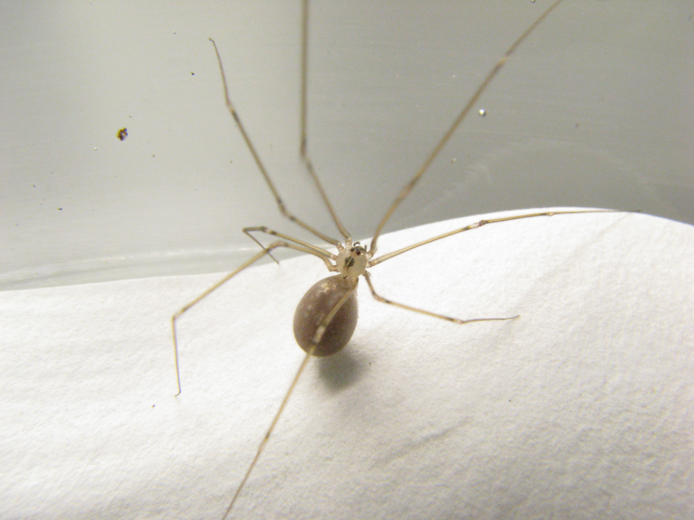
The influence of resource value and resource holding potential in invasive Pholcus manueli
Alex Salazar^{1,2}, Alex Berry² Ann Rypstra²
¹Minnesota State University, Mankato, ²Miami University
Introduction
Materials and Methods
Results Cont.
Invasive species are a global threat whose impact is best seen through their: range, abundance and per-biomass effect (Parker et al., 1999)
Spiders are predators in most terrestrial systems yet little is known on the mechanisms by which they invade
The cellar spider, Pholcus manueli is invading areas where the cellar spider P. phalangioides dominates
Could be through direct competition, via two avenues (Parker, 1974):
resource holding potential (RHP) when size and strength determines the outcome
resource value (RV) when motivation determines the outcome
Measured size (patella-tibia)
Contests staged by introducing P. manueli to P. phalangioides’ container
Observed for 20 minutes for:
Time before 1st contact
Who initiates the aggressive interactions
None, Even, P. manueli, P. phalangioides
Amount of aggressive interactions
Win/Lose
Study Species
Results
Figure 4: Average percent of aggressive encounters won by the P. manueli broken down by the initiator of the encounter and the P. manueli diet. Vertical error bars represent ± 1 SE.
P. phalangioides established in SW Ohio since 1800’s
P. manueli began displacing P. phalangioides between 2008-2010
Conclusion
Resource holding potential in important: bigger and well fed spiders win contests
Resource value is less important – hungry spiders with more to gain engaged slowly, were less aggressive
P. manueli are smaller at adulthood and its success might be tied to RHP when adults engage in fights with young P. phalangioides
Size of P. manueli relative to P. phalangioides
Figure 1: Average percent of aggressive encounters won by the P. manueli compared to the P. manueli size relative to the P. phalangioides. Vertical error bars represent ± 1 SE.
Figure 2: Average time until first contact over P. manueli diet. Vertical error bars represent ± 1 SE.
Acknowledgements
Hypothesis
Thanks are due to: Miami University, NSF,
Patrick Garrett, and the Miami Spider lab.
H: Differences in RHP and RV influence success rate in P. manueli’s ability to displace P. phalangioides
P₁: Bigger spiders will win more contests (RHP)
P₂: Hunger will increase the amount of aggressive behavior (RV)
P₃: Increased aggressive behavior will increase the success rate of the P. manueli
Figure 3: Average percent of encounters initiated by neither spider (none), both (even), P. manueli (MN, or P. phalangioides (PH) across P. manueli diet.
Percent initiating
References
Parker, G.A. (1974) Assessment strategy and the evolution of fighting behaviour. J Theor Biol ,47:223-243.
Parker, I. M., Simberloff, D., Lonsdale, W. M., Goodell, K., Wonham, M., Kareiva, P. M., Williamson, M. H., Von Holle, B., Moyle, P. B., Byers, J. E., Goldwasser, L. (1999). Impact: Toward a framework for understanding the ecological effects of invaders. Biological Invasions, 1:3–19.
Low Well
Diet

