Slide 1
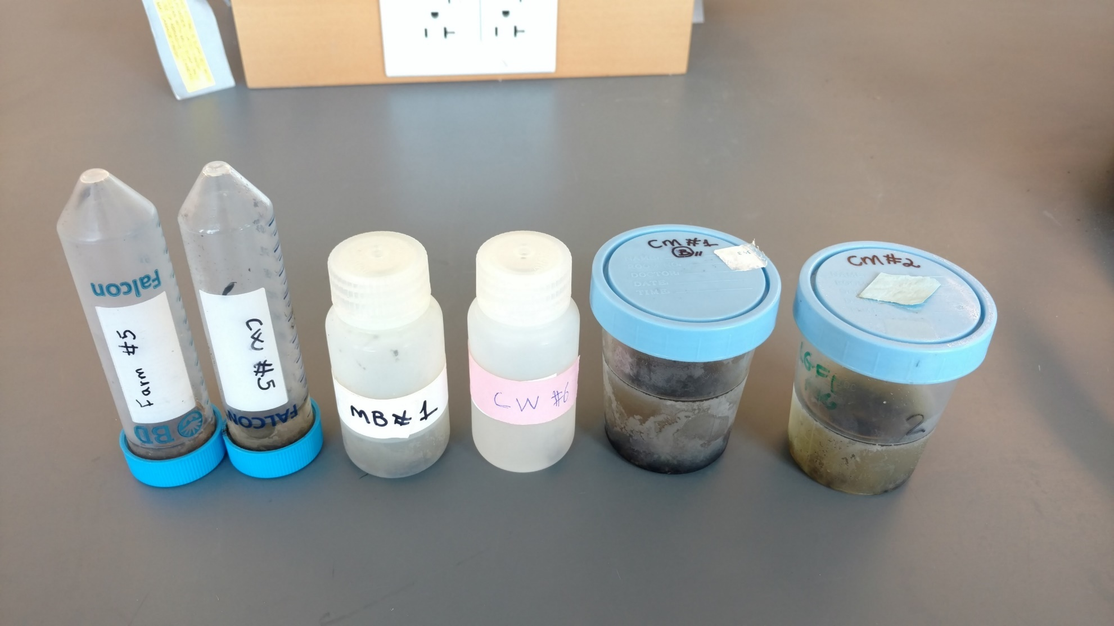
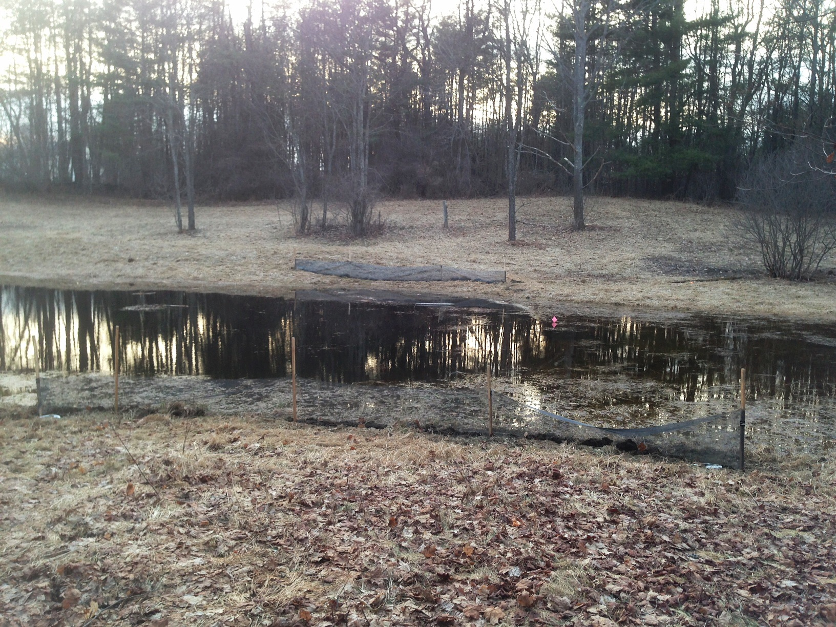
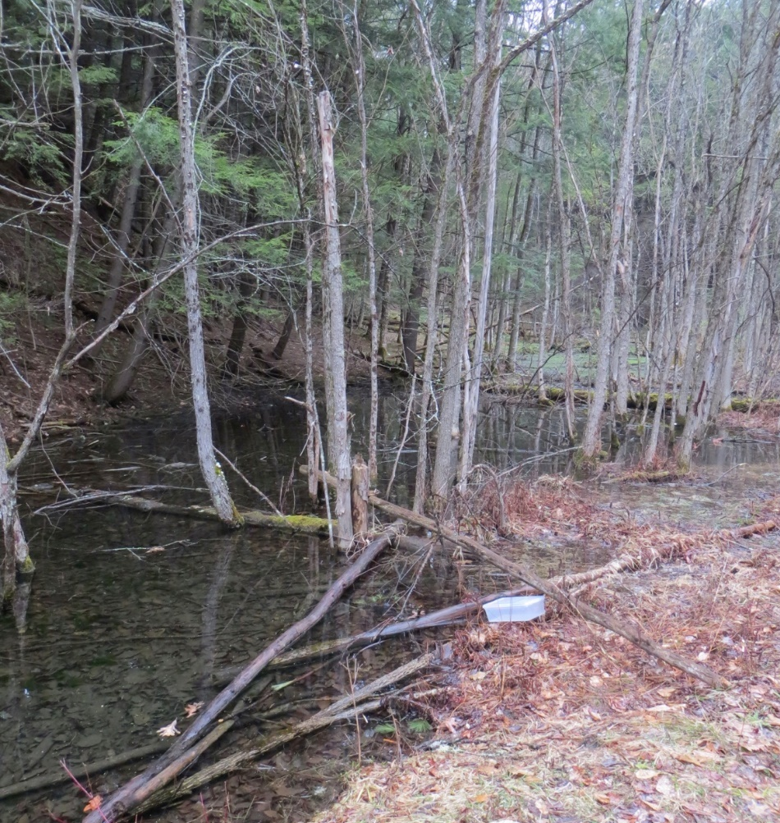
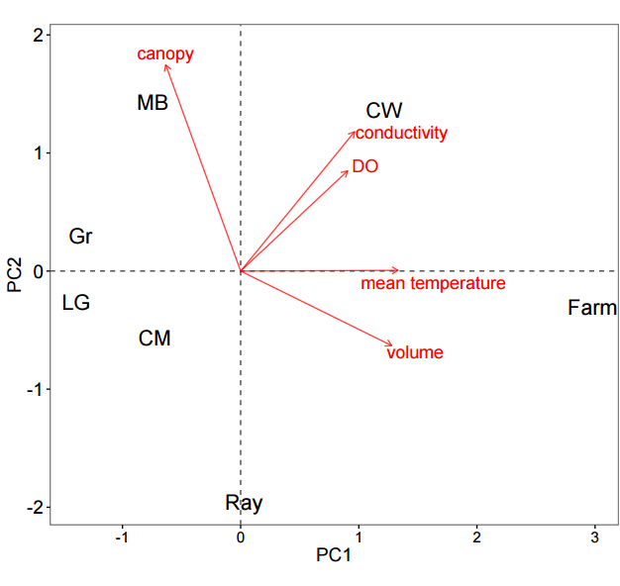
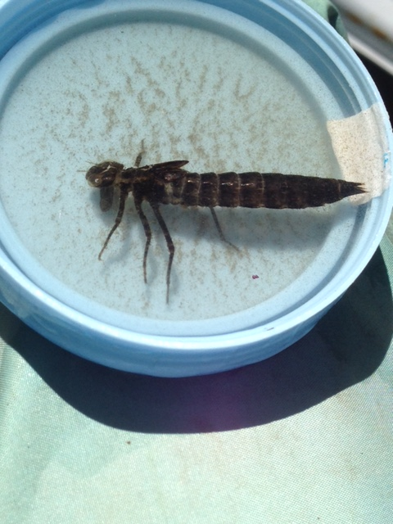
The Effects of Pond Characteristics on Communities of Large Invertebrates
Alexander R Salazar^{1,2}, Debora Goedert^{3,4}, Craig D Layne³, Kathryn L Cottingham³, Ashley K Lang³, Fiona V Jevon³, Ryan G Calsbeek³ ¹Minnesota State University, Mankato, ²ASURE, ³Department of Biological Sciences, Dartmouth College, Hanover – NH, ⁴CAPES Foundation, Ministry of Education of Brazil, Brasília-DF, Brazil
Introduction
Methods
Results
Biotic and abiotic environmental conditions in small ponds can determine the habitat for organisms, including large (>2cm) invertebrates. Some biotic and abiotic characteristics of interest are^{1,2,3}:
Hydroperiod
Depth and area (volume)
Mean temperature
Dissolved oxygen (DO)
Conductivity
Canopy cover
7 ponds were chosen around the Hanover area
Invertebrates were sampled (starting 1m from the edge of the pond) using a net on a transect along the longest side of each pond with sampling points every 10m
Sampling effort was standardized for area of the pond (mean 5.8%±1.3%SD)
Mean temperature was calculated from daily measurements taken throughout May
DO and conductivity were measured at time of sampling
Canopy cover was averaged from each sampling point along the transect
Invertebrates were identified to family level in lab using a dissecting microscope
Figure 3. Samples of invertebrates from various ponds
Figure 4. Axes PC1 and PC2 of a Principal Component Analysis on pond characteristics. Mean temperature, volume, dissolved oxygen (DO) are loading mainly along PC1, while canopy cover, DO, and conductivity are along PC2.
Results
We have found 8 orders and 18 families of invertebrates and preliminary analysis shows that there is a positive relationship between the richness of families in a pond and mean temperature, volume, and conductivity. While canopy cover and DO appears to have a positive affect, it is not as significant.
Figure 1. Examples of ponds. Ray (left) shows a low canopy cover and MB (right) with high canopy cover.
Objectives
The objective was to investigate whether the aforementioned pond characteristics would have an affect on the richness of large invertebrates.
Figure 5. Number of families by pond characteristics represented in PC1; indicating that more families are expected to found as volume, mean temperature, DO, and conductivity increase. The solid line indicates predicted values from a generalized linear model (Poisson distribution) with dash lines showing a 95% confidence interval.
Table 1. All invertebrates collected were identified to the family level. The total amount of invertebrate families found for each pond are listed.
p<0.001
Conclusions
Pond characteristics, such as mean temperature, volume, conductivity, and DO have an effect in large invertebrate communities. Richer communities are found in ponds where mean temperature, volume, conductivity, and DO are greater. Canopy cover does not have a significant effect on invertebrate richness.
Pond Name | # of Families
MB | 3
LG | 1
Farm | 17
Gr | 1
Ray | 6
CW | 10
CM | 3
Significance
The identified invertebrates inhabit an important niche where they are prey for larger organisms, while also predating upon smaller organisms. This relationship is an important factor that must be taken into account when considering pond conservation. Thus, it is important to know what factors affect the presence, or lack thereof, of these invertebrates.
Figure 2. A dragonfly belonging to the Aeshnidae family.
Mean Temperature, Volume,
Conductivity, and DO
The number of families in a pond has a positive correlation with PC1 (a higher mean temperature, greater volume, and greater conductivity).
¹ Gioria M, Schaffers A, Bacaro G & Feehan J. The conservation value of farmland ponds: Predicting water beetle assemblages using vascular plants as a surrogate group. Biological Conservation 143, 1125-1133 (2010).
² Kusch J, Leather SR & Sahlen G. Interacting influences of climate factors and land cover types on the distribution of caddisflies (Trichoptera) in streams of a central European low mountain range. Insect Conservation and Diversity 8, 92-101 (2015).
³ Hamasaki K, Yamanaka T, Tanaka K, Nakatani Y, Iwasaki N & Sprague DS. Relative importance of within-habitat environment, land use and spatial autocorrelations for determining odonate assemblages in rural reservoir ponds in Japan. Ecological Research 24, 597-605 (2009).

